Slide 1
Engaging the Public in
Neighborhood Policing
CRIMEREPORTS.COM
Greg Whisenant
Gov 2.0 Summit, Washington DC

Slide 2
Better Information =
Better Decisions
Price of Gas Goes Up
Drive Less
Better car
Ride a bike Public transit
Did a crime happen?
What can I do about it?
?

Slide 3
So….
Where is the Crime Data?
Notes:
With data driving every decision we make, here we sit in 2009 and we’re not able to get crime data on a timely basis.
Why?

Slide 4
15-second Civics Refresh
Federal – State - Local

Slide 5
Who’s In Charge Here?
Sorry, Mr President
…this one belongs to the locals

Slide 6
Every Agency Has One of These:
911 System
Records System
Supporting Staff and Systems
$$ = Expensive Legacy System

Slide 7
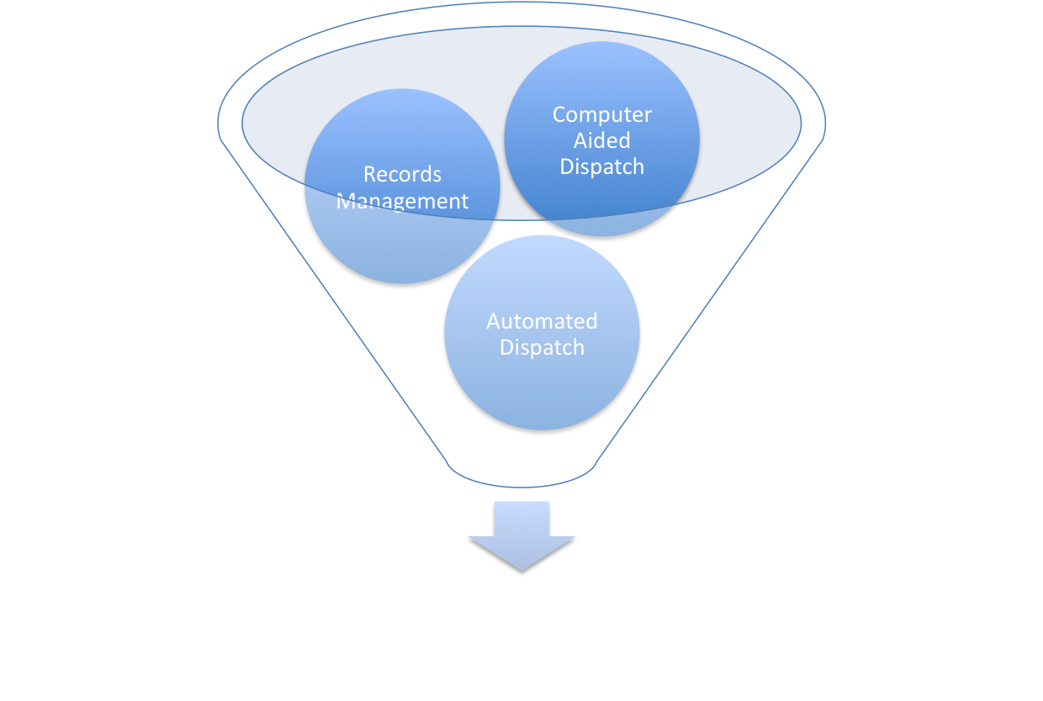

Slide 8
More than
18,000
Law enforcement agencies in the US

Slide 9
Can Law Enforcement Agencies Do Better?
Question:

Slide 10
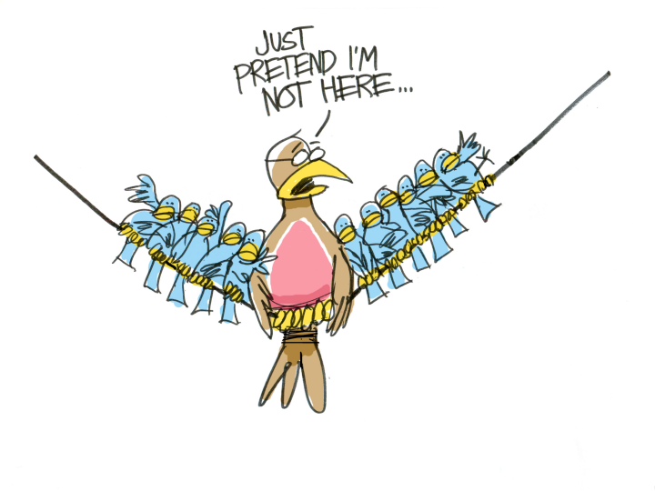
Okay…
…So Who’s In Charge?

Slide 11

Audience Participation
Maybe not the best way.

Slide 12
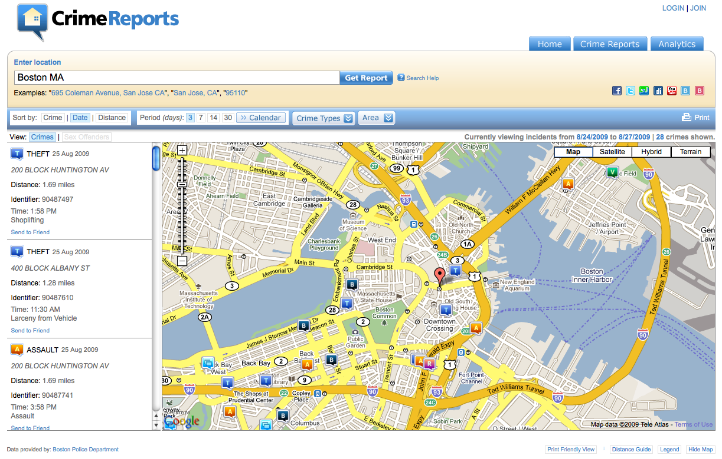

Slide 13


Slide 14
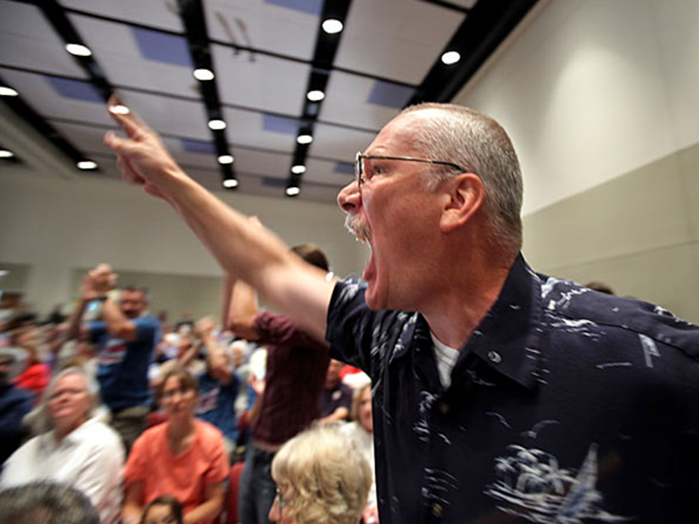
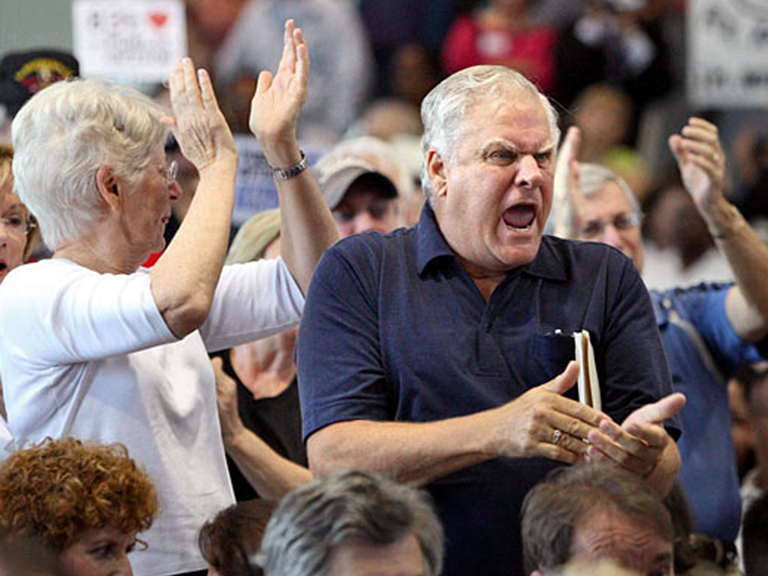
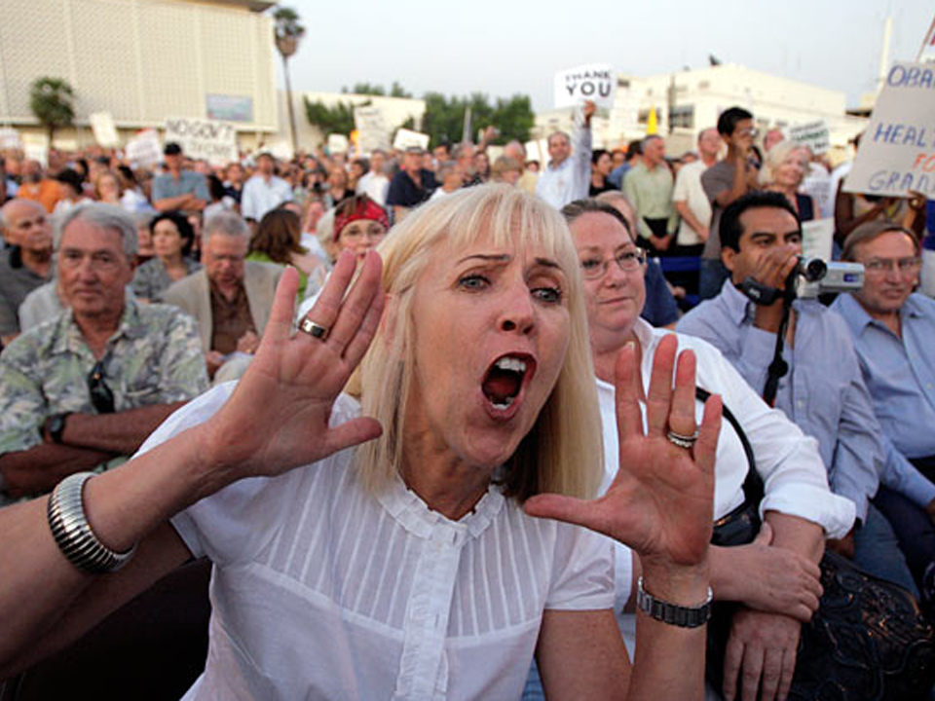
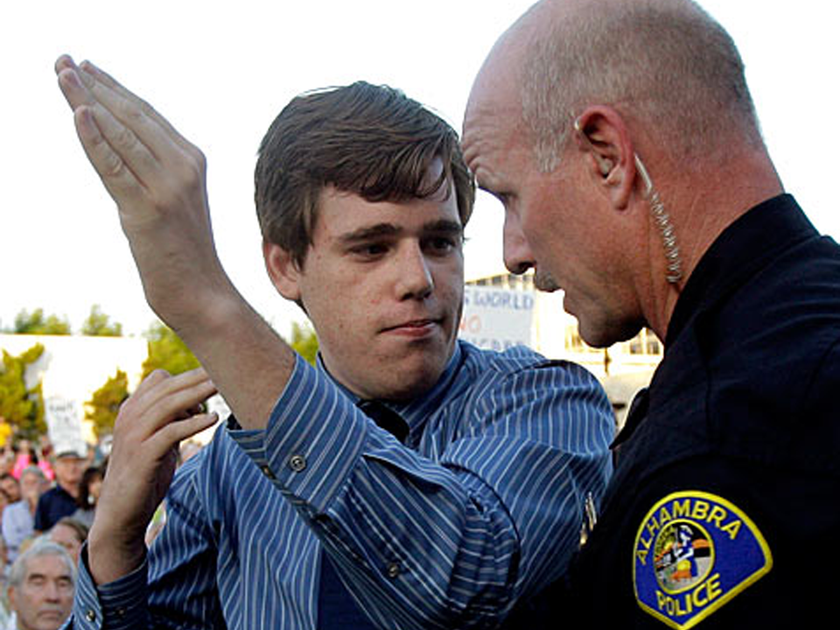
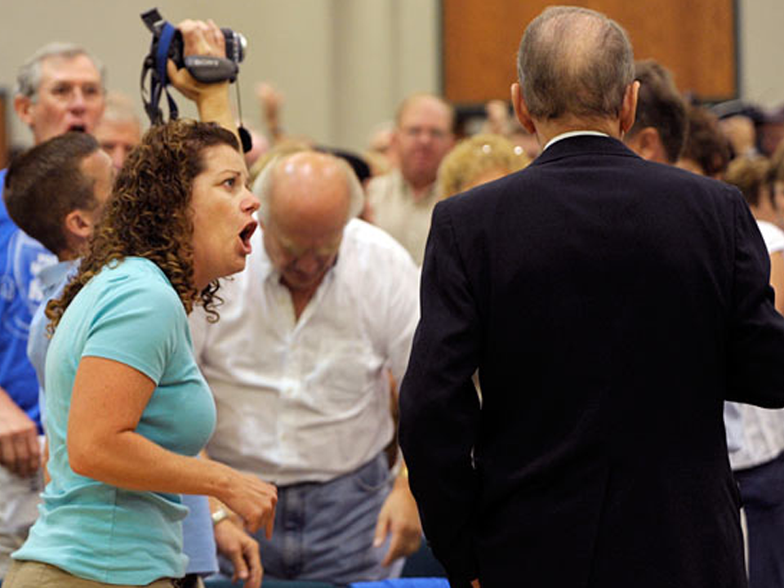
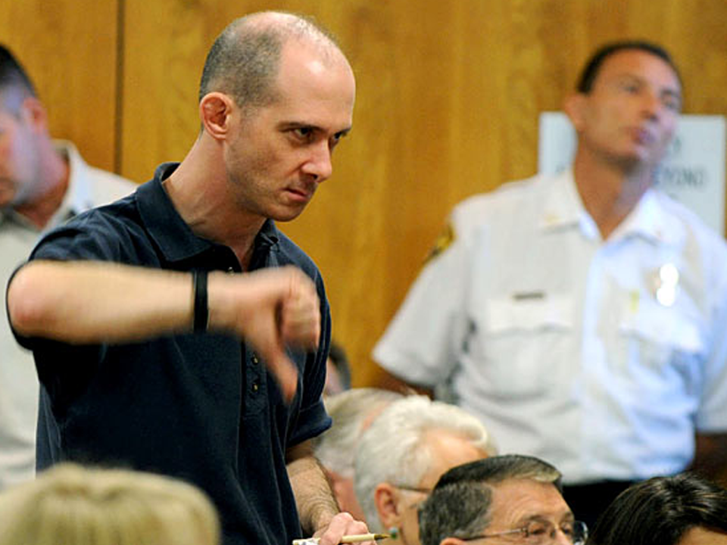

Slide 15
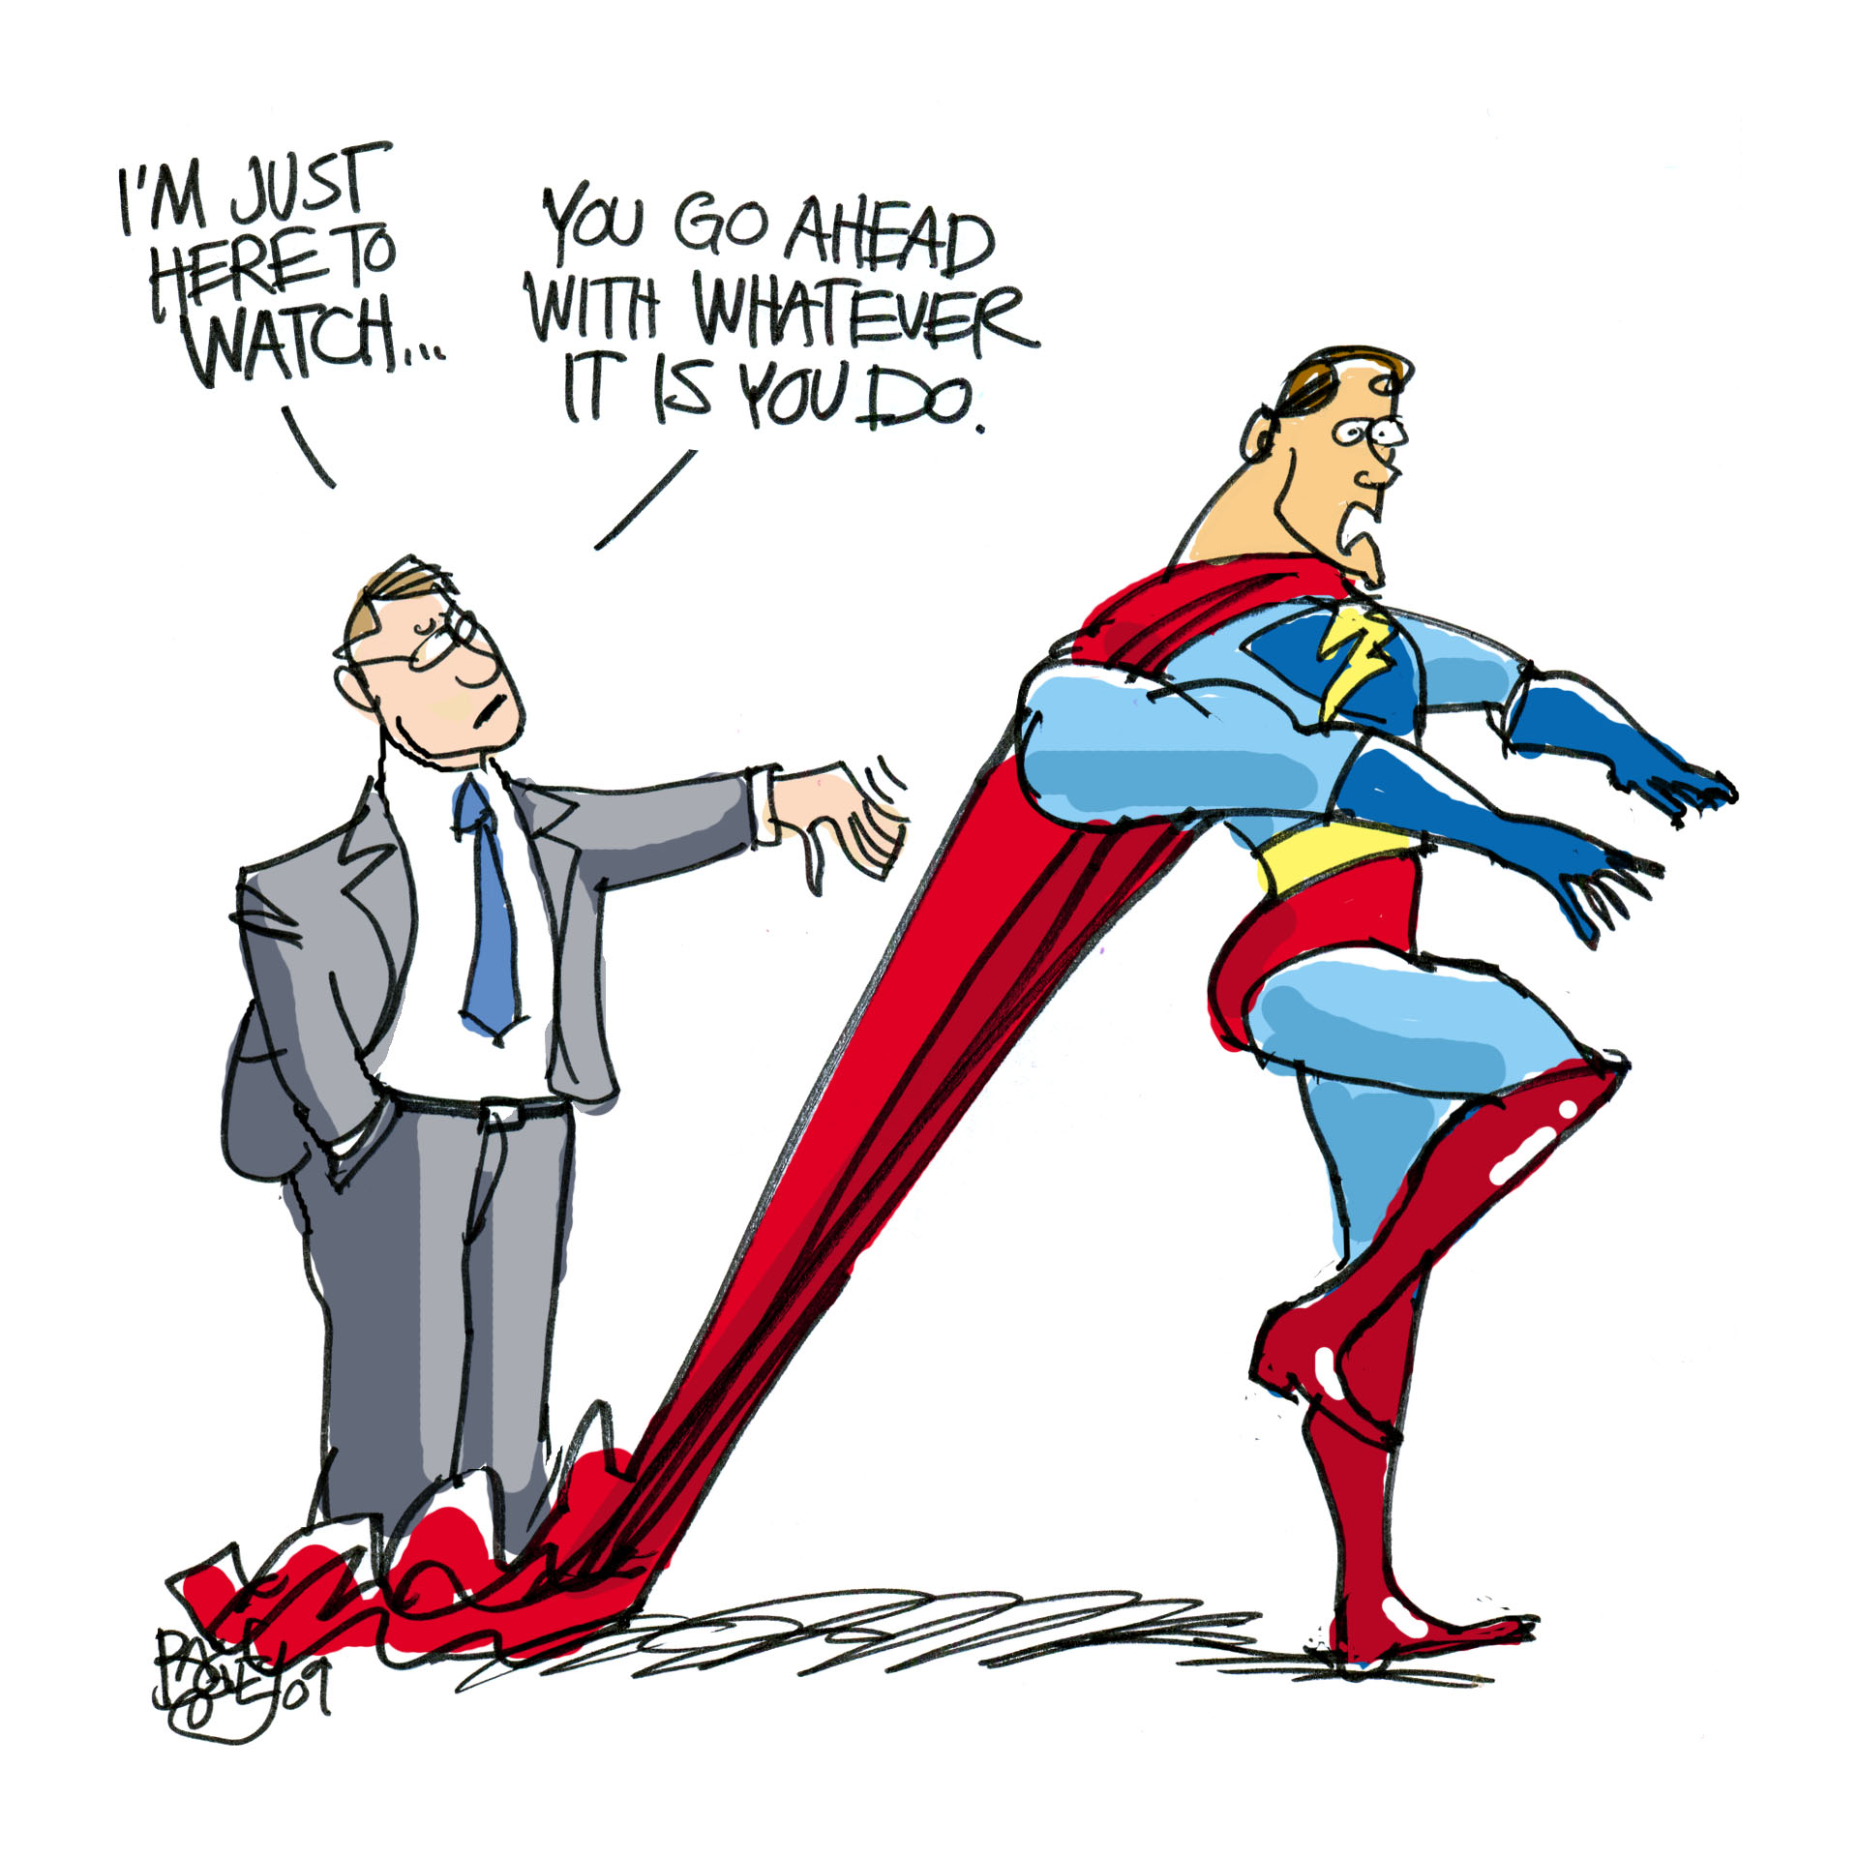

Slide 16





Government can be a great partner!
…but it helps to treat them like human beings.

Slide 17
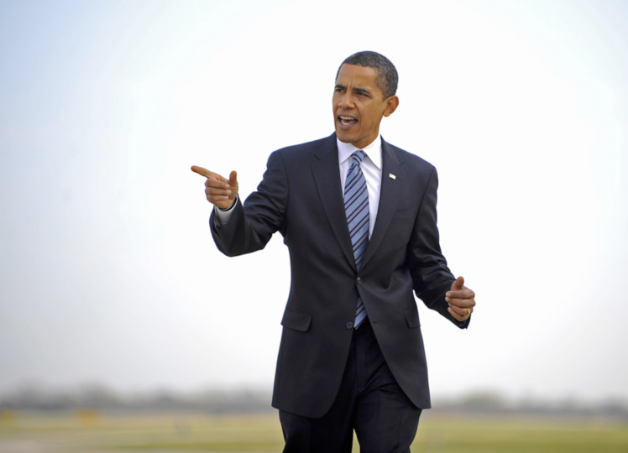
Law Enforcement:
A Closer Look

Slide 18
What can the President do?
Attract people who understand Web 2.0
Priority to grants that create a Web 2.0 public role
Friendly stance to legislation that creates a Web 2.0 public role

Slide 19
Recap
Better Data = Better Decisions
Specific Local Example: CrimeReports.com
Set Expectations with the Public (Fast & Easy)
The President’s Power: Lead

Slide 20

(Seriously, thank you!)
Greg Whisenant
greg@crimereports.com
801-828-2710

